Slide 1

Dr.Mahalingam College of Engineering & Technology
Emerging technology : Blockchain
~Sujitha V
~Karthick Pranesh GSD

Slide 2

What is Blockchain Technology?
Blockchain technology is a digital ledger system that records, stores, and verifies data in a secure, distributed, and immutable way.
It is a decentralized system that enables the transfer of digital assets without the need for a trusted third party.
Blockchain technology has the potential to revolutionize many industries and the way we conduct business. It can be used to securely store and transfer data, create smart contracts, and provide a secure platform for digital asset trading.

Slide 3


History of Blockchain Technology
The concept of blockchain technology was first introduced in 1991 by Stuart Haber and W. Scott Stornetta.
It was further developed in 2008 by Satoshi Nakamoto, who created the first blockchain-based on cryptocurrency, Bitcoin.
Stuart Haber
W. Scott Stornetta

Slide 4
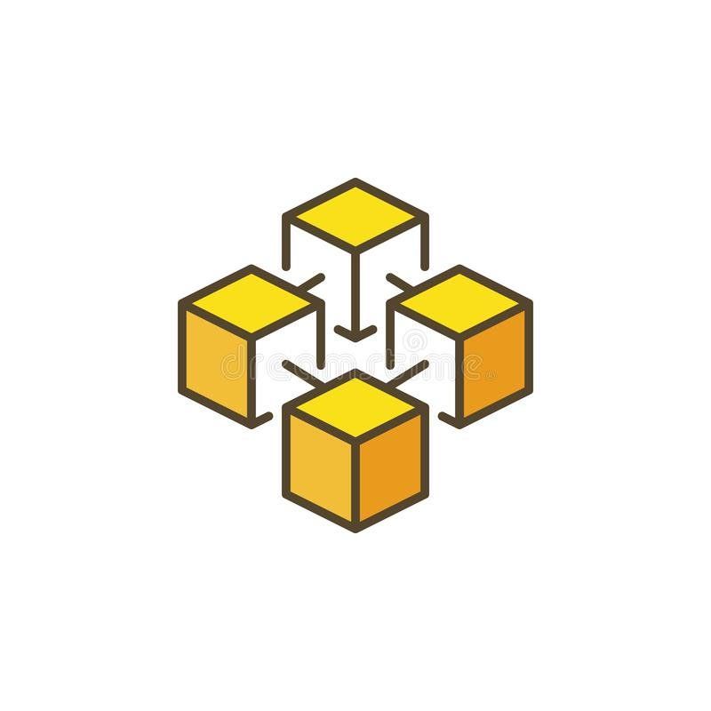
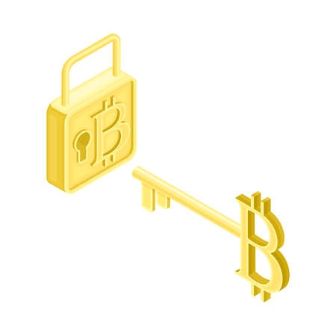
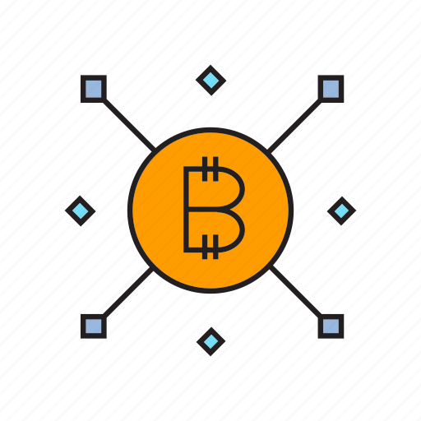
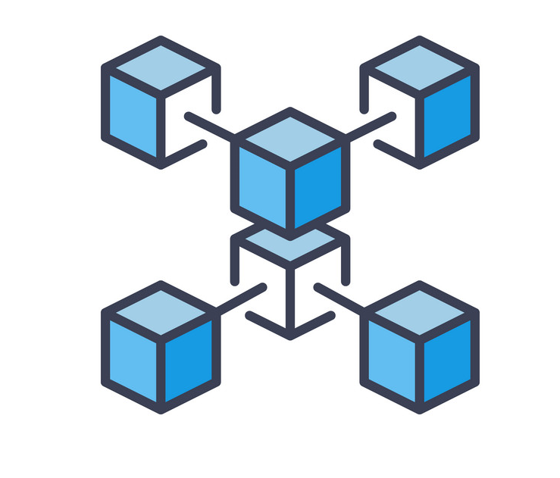
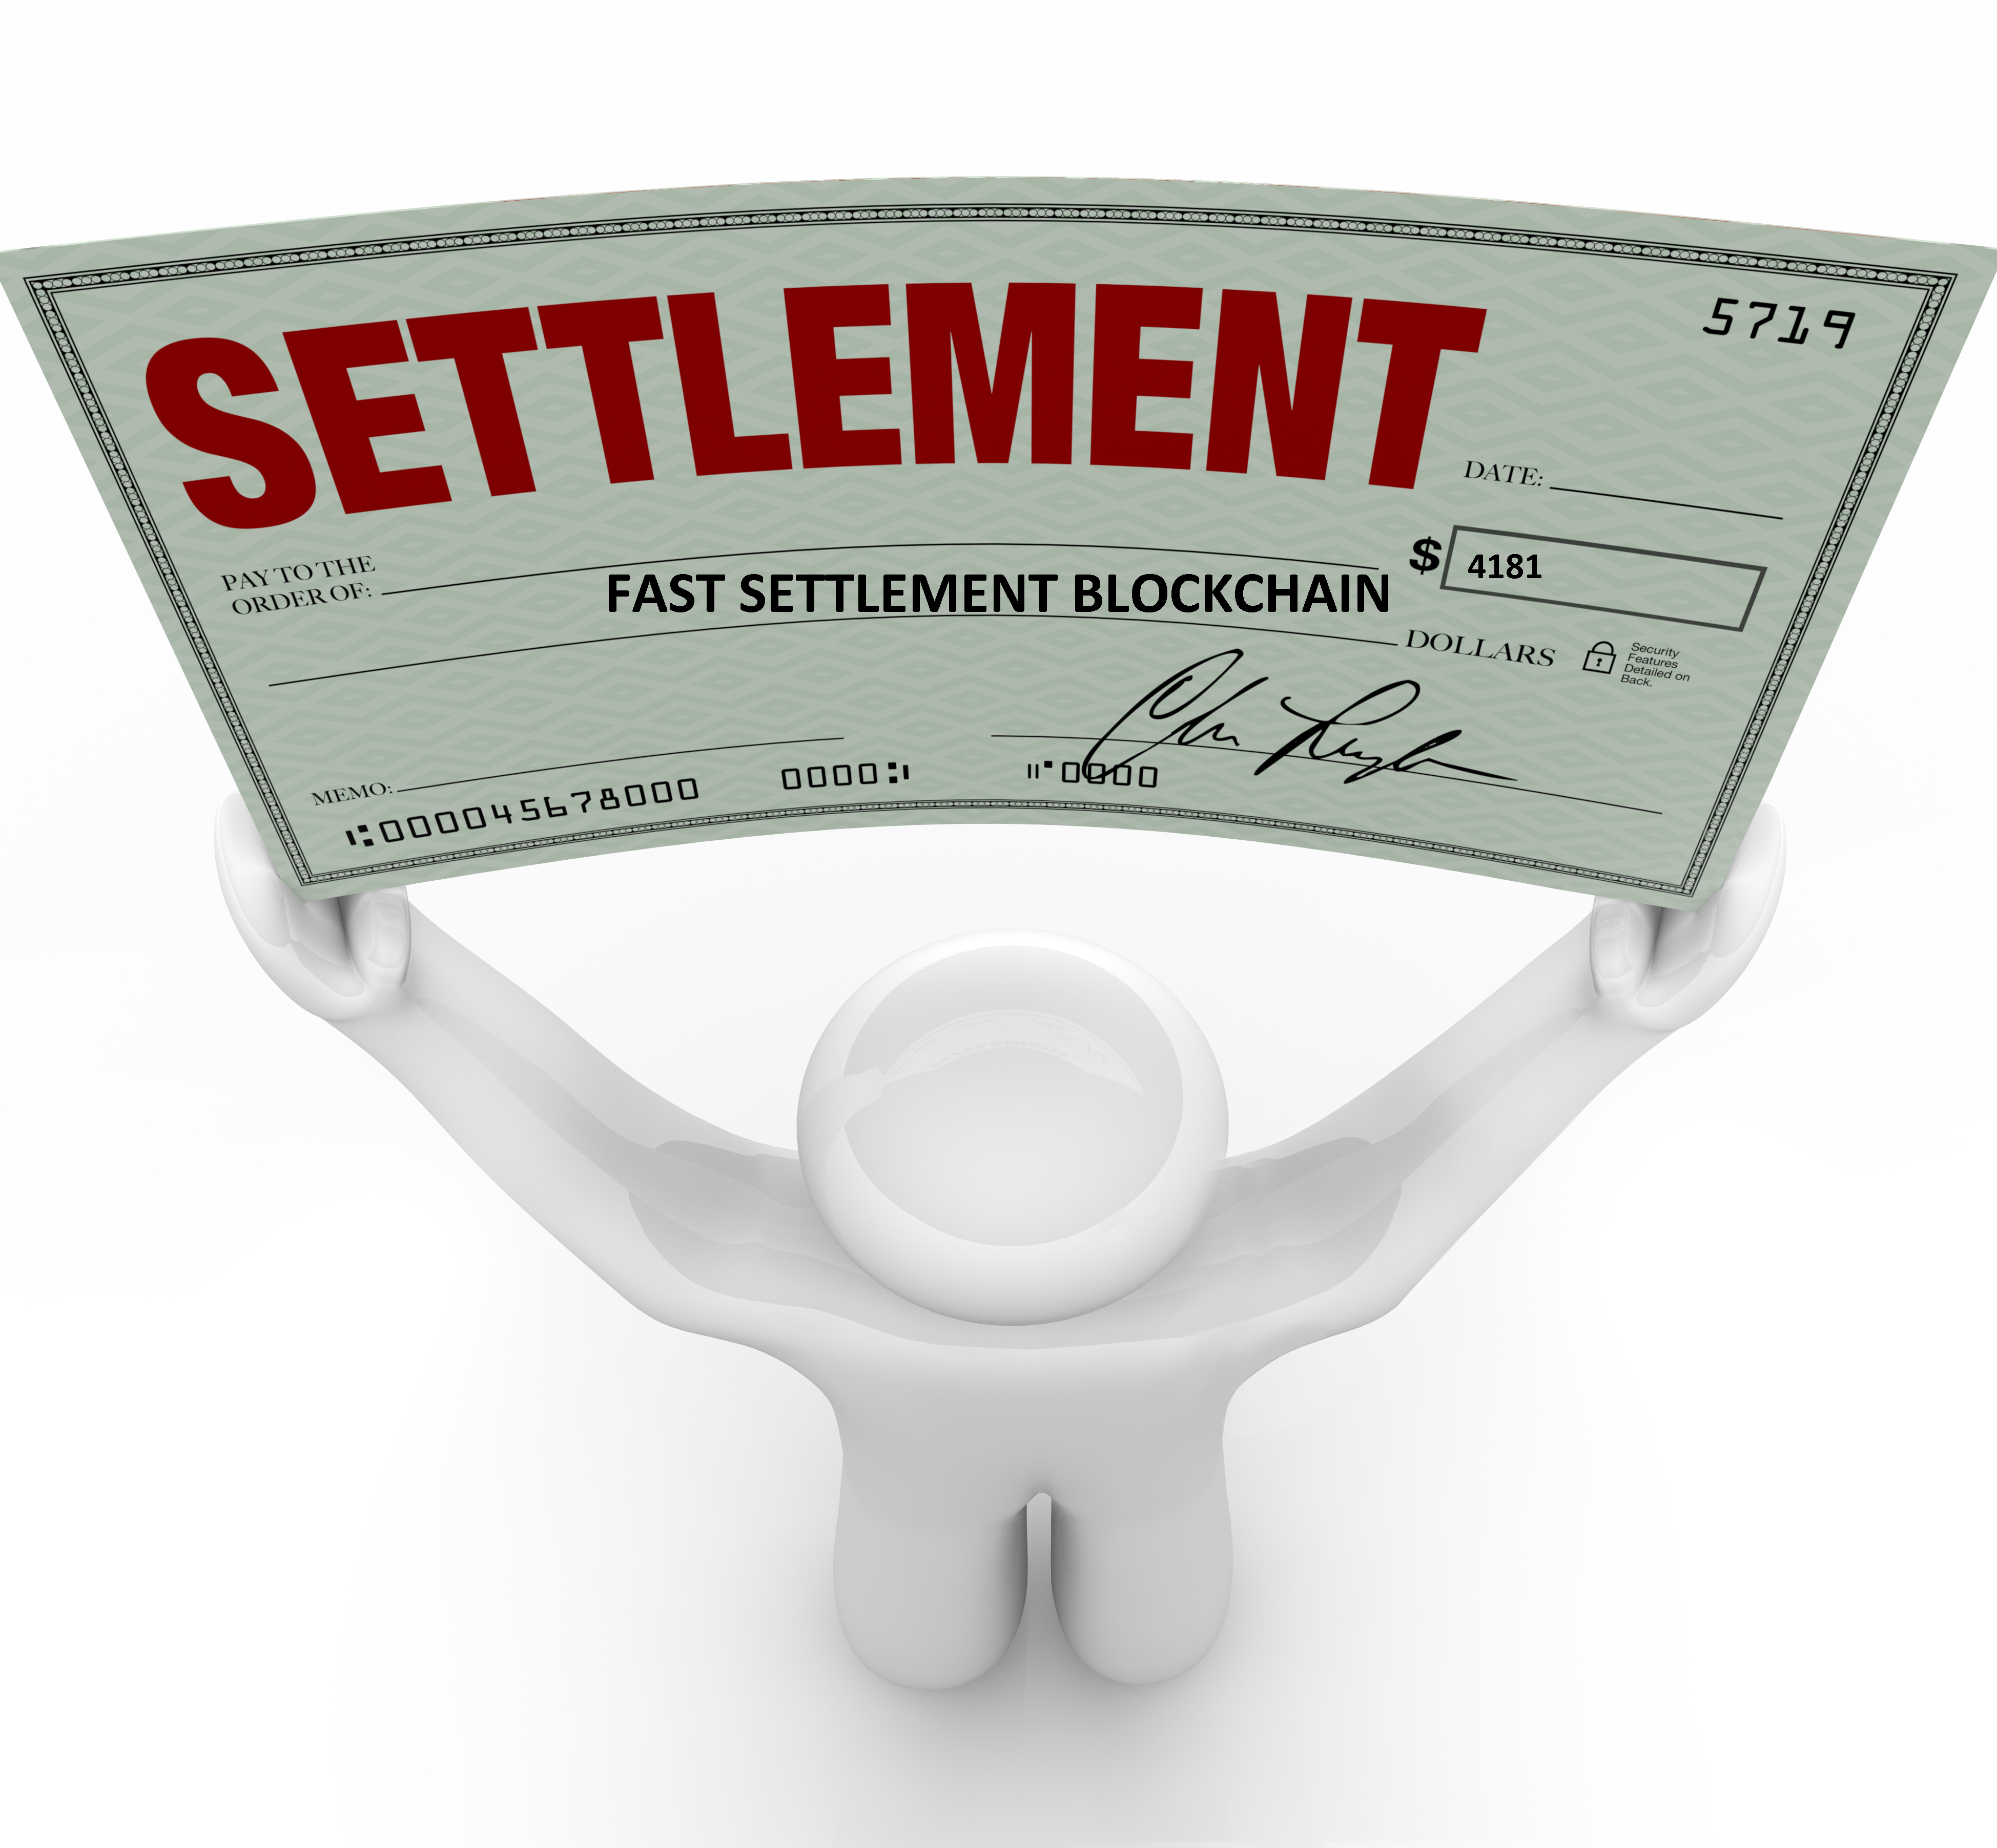

Top 6 Main Features of Blockchain Technology
Immutable
2. Secure
3. Decentralized
4. Distributed
5. Faster Settlement
6. Consensus

Slide 5


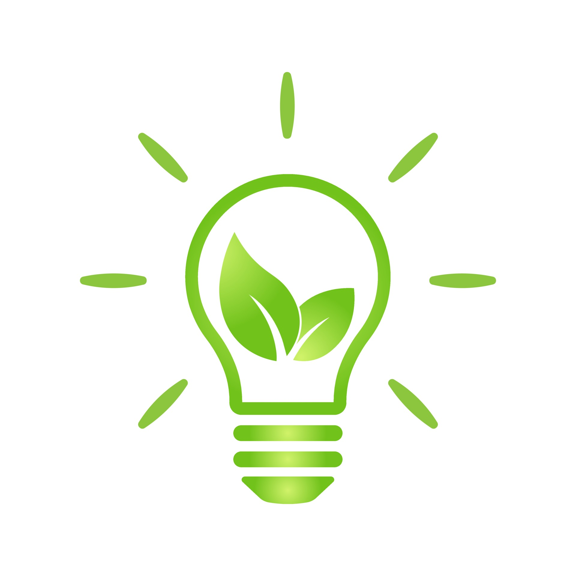
Most Uses of Blockchain Technology
Transparent, trustless and immutable system for healthcare
Greater liquidity and automated property management
Peer-to-peer distribution, better energy management

Slide 6
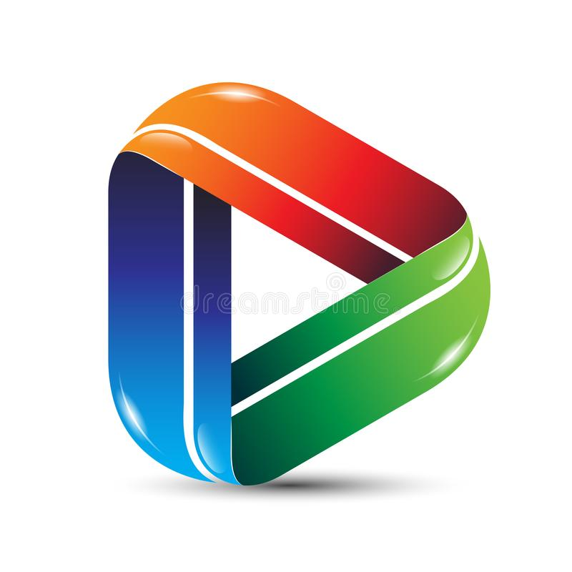
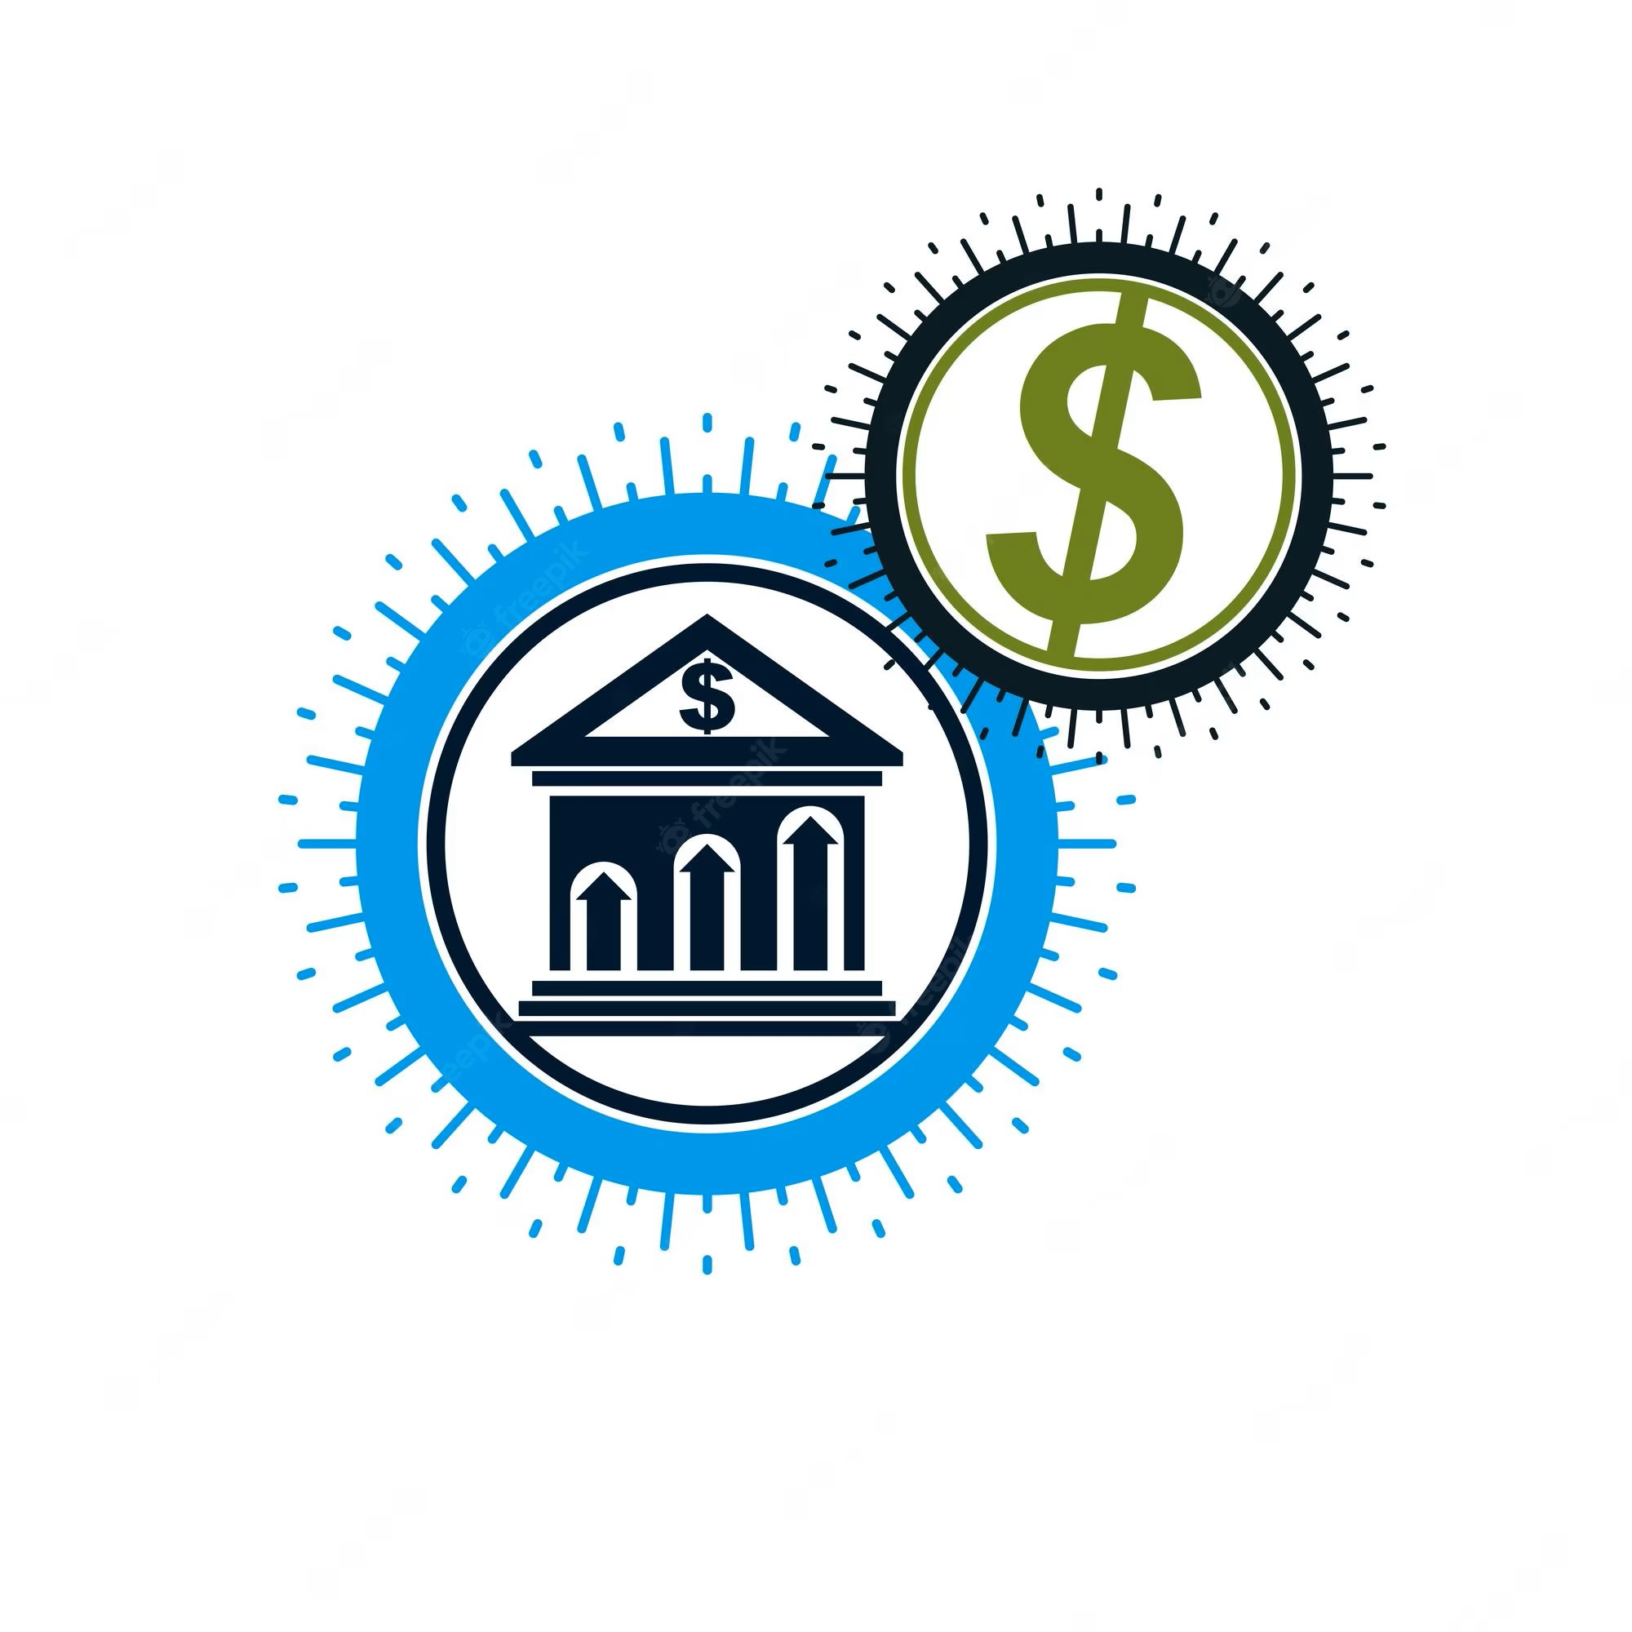
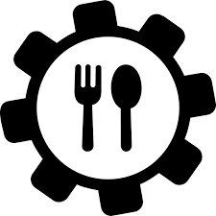


No fees, no intermediates, and better reach
Better KYC/AML, faster interbank transactions, and data security
Better food tracking from origin to the consumption
Better automation and the ability to distribute data transparency
Less paperwork, automated insurance audits and claims
eSport management, and improved production process

Slide 7

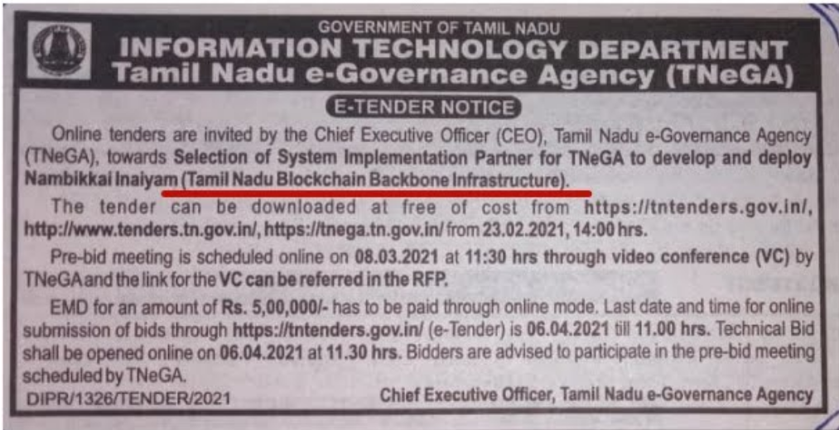
Tamil Nadu’S First Blockchain Policy in 2020

Slide 8
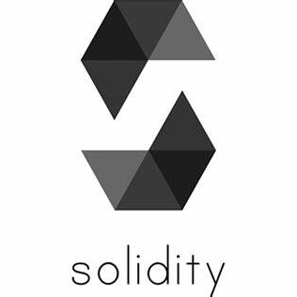

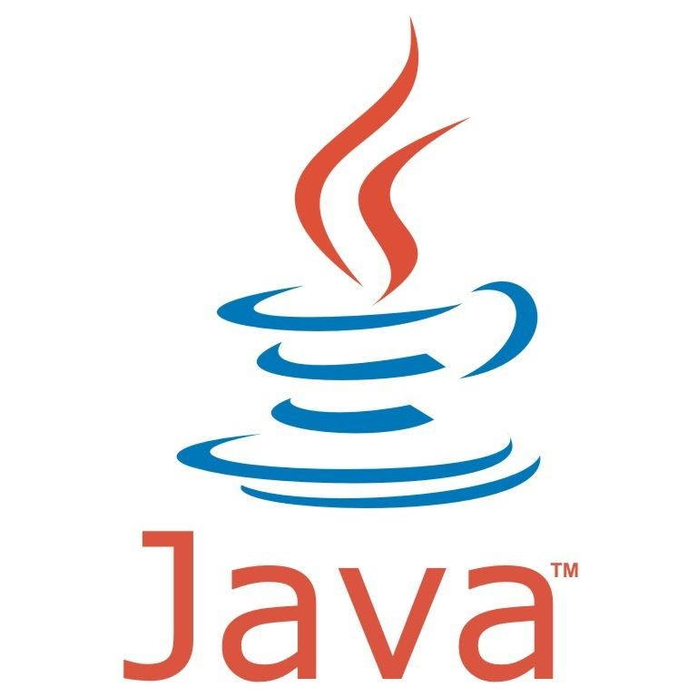
Languages for developing blockchain technology
Solidity is a high-level programming language that is specifically designed for writing smart contracts on the Ethereum blockchain.
Go is a popular programming language known for its simplicity and efficiency. It’s commonly used for building scalable & high-performance blockchain applications
Java is a widely-used programming language known for its security features & cross-platform compatibility. It’s often used for building enterprise-grade blockchain applications.

Slide 9
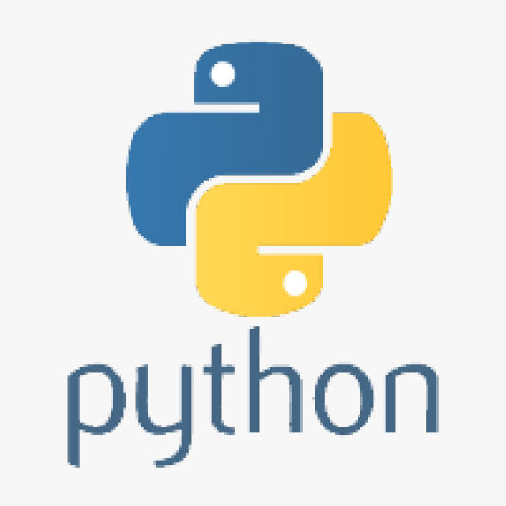
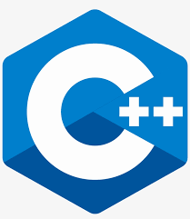
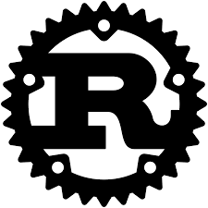
Python is a versatile programming language that is widely used for building a variety of applications, including blockchain applications.
C++ is a powerful programming language that is commonly used for building high-performance blockchain applications.
Rust is consistently ranked the most-loved programming language. it’s type- and memory-safe, and those safety features Rust is used to build smart contracts on chains.

Slide 10
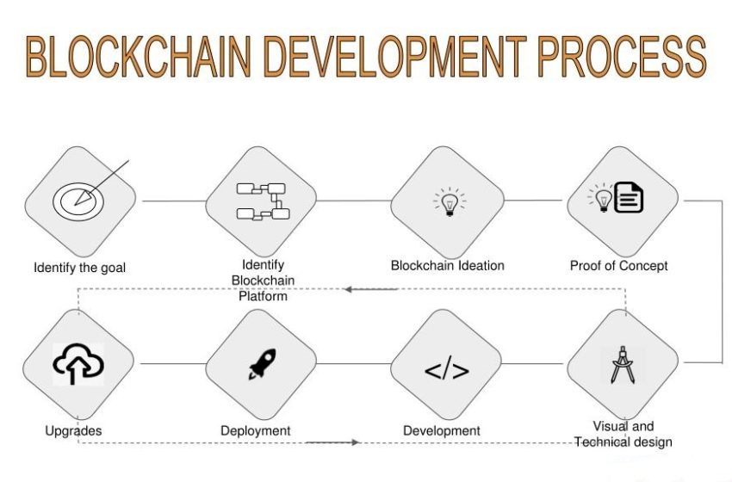
Blockchain development life cycle
Identify the problem and goal
Identify the Most Suitable Consensus Mechanism
Identify the most important platform
Designing the architecture
Configuring the Application
Building the APIs
Design the admin and User Interface
Scaling the POC and Identifying problems

Slide 11
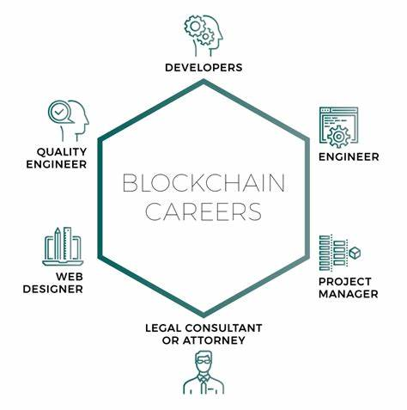
What does a blockchain engineer do?
Designing & Developing Blockchain Solutions
Creating & Managing Blockchain Networks
Writing Smart Contracts
Building Cryptocurrency wallets
Testing & Debugging
Keeping Up with the Lastest Developments

Slide 12
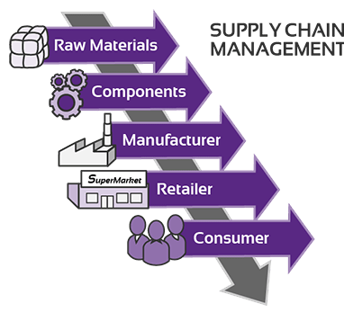
blockchain technology in industrial sector
Supply chain management: Blockchain can help to streamline supply chain management by providing a secure and transparent ledger for tracking products from production to delivery. This can improve efficiency and reduce costs by eliminating the need for intermediaries.

Slide 13
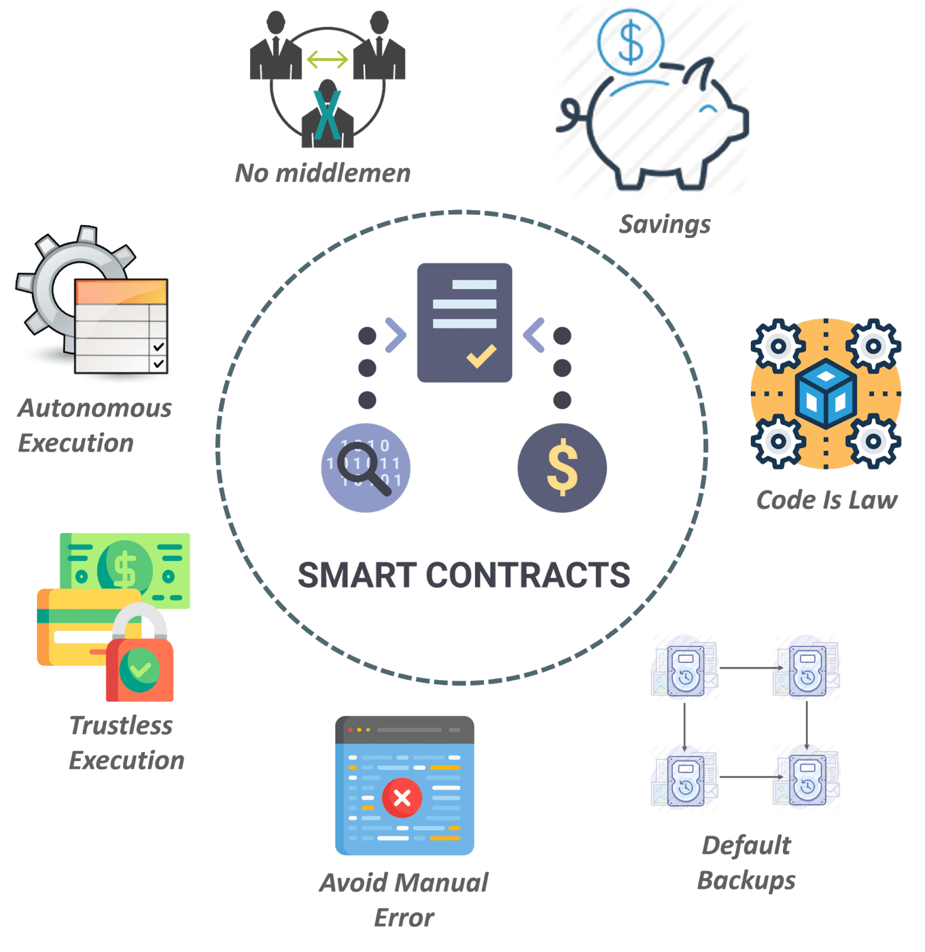
blockchain technology in industrial sector
Data sharing: Blockchain can facilitate secure data sharing between different organizations within the industrial sector, such as manufacturers, suppliers, and distributors. This can help to improve collaboration and decision-making, while maintaining the privacy and security of sensitive data.
Smart contracts: Blockchain can be used to automate contract execution and enforcement, reducing the need for intermediaries and improving the efficiency and security of transactions.

Slide 14
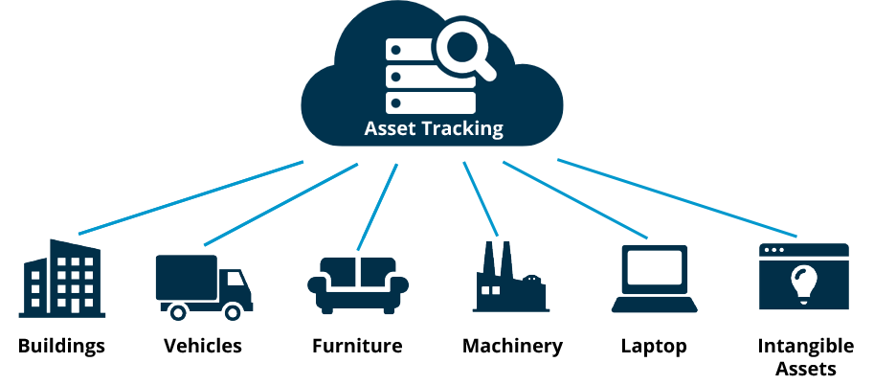
blockchain technology in industrial sector
Asset tracking: Blockchain can be used to track assets such as equipment, machinery, and vehicles, providing a secure and transparent ledger for monitoring their status and location. This can help to improve maintenance and repair processes, and reduce the risk of theft or loss.

Slide 15
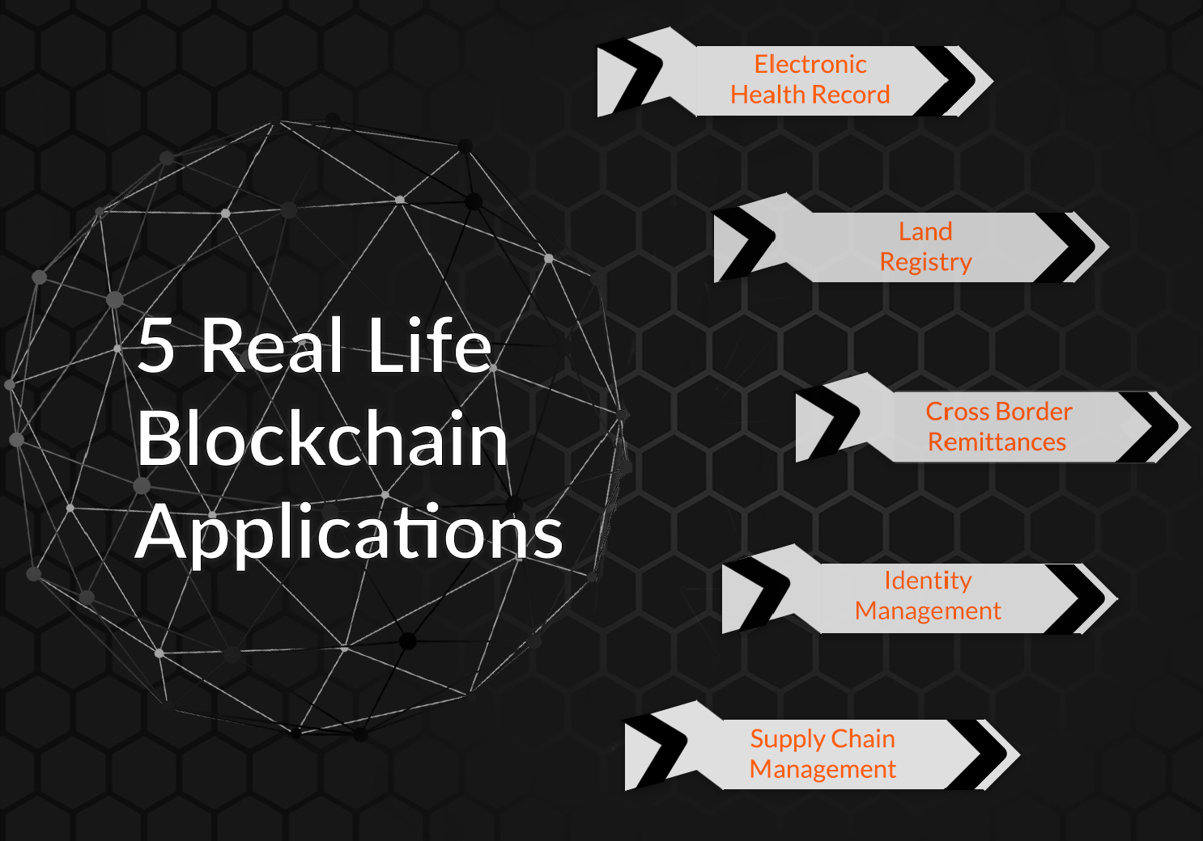
5 Blockchain application In Real Life
Blockchain in Electronic Health Record
Blockchain acting as Land Registry
Blockchain in Cross Border Remittances
Blockchain Supply Chain Management
Blockchain in Identity Management

Slide 16
Why Blockchain technology is the Future?
Blockchain technology has the potential to revolutionize various industries and reshape the way we interact and conduct transactions.
Blockchain technology offers a range of benefits that make it a promising technology for the future. While there are still some challenges to overcome, such as scalability and interoperability, the potential benefits make it an exciting area for further development and exploration.
Here are some reasons why blockchain technology is the future:
Decentralization 3. Transparency 5. Potential innovation
2. Security 4. Smart contracts

Slide 17
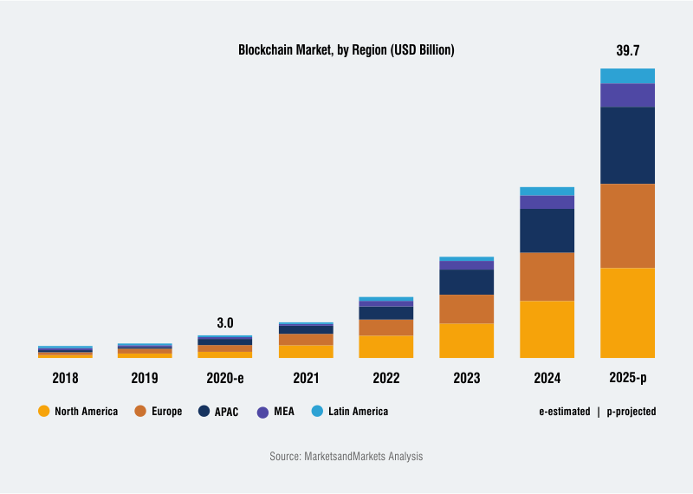
Graphical Representation of Blockchain Technology

Slide 18
